Slide 1



Slide 2


Slide 3


Slide 4


Slide 5


Slide 6
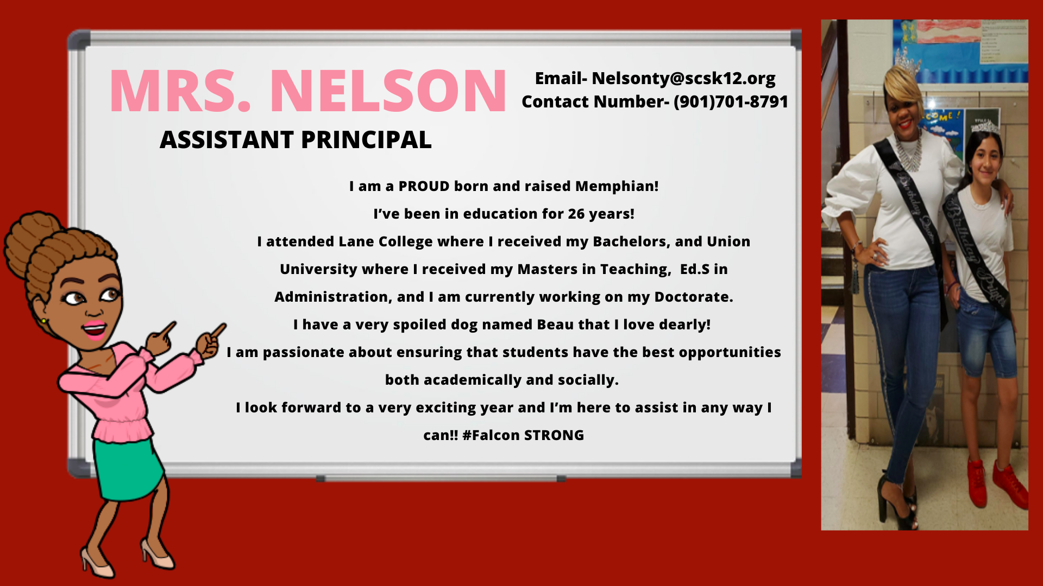
THE STUDENT CONDUCT GUIDEBOOKS FOR PARENTS

Slide 7


Slide 8


Slide 9

PSC
NEWSLETTER
PSC WHEATLEY
VIRTUAL
OFFICE
Email:
andersonac2@scsk12.org

Slide 10


Slide 11
KMS Teachers
6A
K. Searle | ELA
K. Johnson | Math
K. Imperial | Science
Mosby | Social Studies
B. Slesinger | Reading
B. Robertson | Computer
7A
Z. Jenkins | ELA
D. Olison | Math
C. Allen | Science
S. Hayes | Social Studies
T. Miller | Reading
T. Davenport | Art
8A
Mr. Wheatley | ELA
Ms. Weiss | Math
Ms. Strong | Science
Ms. Morgan | Social Studies
Mr. Coyle | Reading
Mrs. Kimmons | Career Exploration
6B
Mr. Canny | ELA
Mr. Adejumo | Math
Ms. Mask | Science
Mr. Haynes | Social Studies
Ms. Pittard | Reading
Ms. Robinson | Computer
7/8
Ms. Donnelly | ELA
Mrs. Jones-Wright | Math
Ms. Lang | Science
Mr. Payne | Social Studies
Coach Wilson | Gym
SPED Team | ESL Teachers
Ms. Bell | Mrs. Montano
Mrs. Levy | Mr. Buggs
Mr. Johnson | Ms. Dial
Mr. Miles | Mr. Alnimri
Mrs. Vaughn | Mrs. Farraj

Slide 12



Slide 13

Getting Started on SCS Device (English)

Slide 14
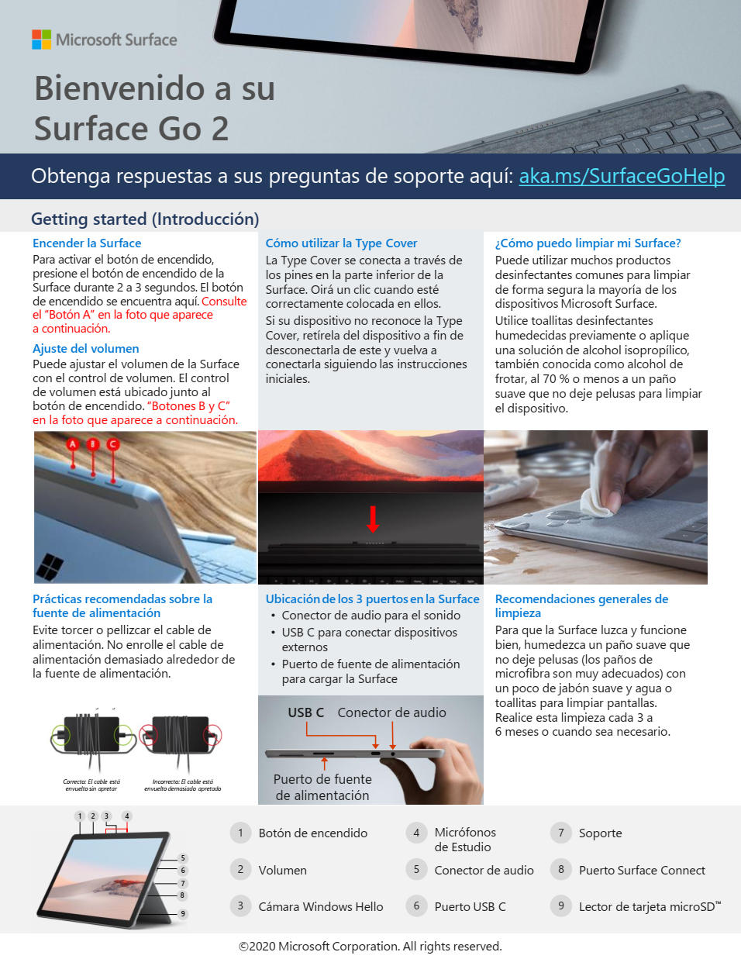
Introducción al dispositivo SCS (Spanish)

Slide 15

الشروع في العمل على جهاز SCS (Arabic)

Slide 16

Helpful Virtual Videos
Connecting to TEAMS- https://youtu.be/PasT3Q1ZR_I
Using your SCS Device & Splitting you screen- https://youtu.be/S5pvn0HQck0

Slide 17

How to use ClassKick with Ms. Dial

Slide 18


Slide 19
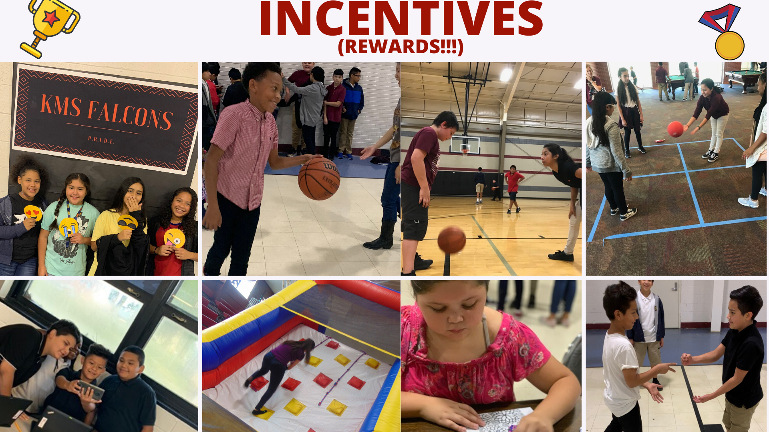

Slide 20


Slide 21


Slide 22


Slide 23


Slide 24

Notes:
Calling all girls interested in playing volleyball or basketball. Both teams are Coached by MR. and Mrs. Wheatley. The motto of our teams is together. No matter what happens we do it together. Being a part of a team provides so much support and lifetime friends.

Slide 25

Notes:
Here are a couple of action shots and sports team pictures. encourage each and every one of you to join some type of school activity. This will help the transition and making friends so much easier.

Slide 26
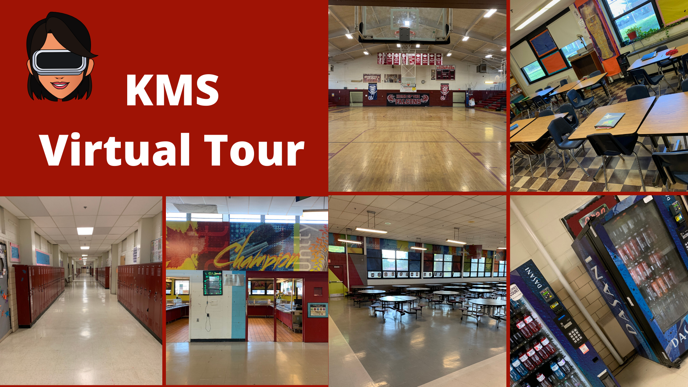

Slide 27


Slide 28


Slide 29






Phone: 901-416-6040
Fax: 901-416-6058

Slide 30
SCS Technology Support
http://www.scsk12.org/accessforall/deviceresources.php?PID=1758

